Slide 1

Embedded Python
Microbit
Dr.M.Jothish Kumar
Assistant Professor Senior,
School of Information Technology and Engineering,
Vellore Institute of Technology, Vellore.

Slide 2
Embedded Python
Python is the best choice for any software developer looking to construct embedded devices.
Python has dominated the IEEE Spectrum programming language ranking.
It has ranked first in Web, Enterprise, and Embedded systems use cases.
This is primarily owing to the programming language's ease of use.
Messages delivered from an embedded device using Python enable end-users to automate tasks.

Slide 3
Embedded Python
MicroPython is another Python version that is commonly used for
running microcontrollers and embedded systems.
Embedded systems rely on integrated circuits to handle computation
for real-time procedures.
From a simple collection of processors to a vast web of graphical user
interfaces, the systems cover a wide spectrum of complexity.
One of Python's many uses is to facilitate and control real-time
embedded systems.

Slide 4
Embedded Python
The MicroPython pyboard is a compact electronic circuit board that runs MicroPython on the bare metal, giving you a low-level Python operating system that can be used to
control all kinds of electronic projects.
MicroPython is packed full of advanced features such as an interactive prompt, arbitrary precision integers, closures, list comprehension, generators, exception handling and more.
Yet it is compact enough to fit and run within just 256k of code space and 16k of RAM.
MicroPython aims to be as compatible with normal Python as possible to allow you to
transfer code with ease from the desktop to a microcontroller or embedded system.

Slide 5
Embedded Python
Python can be used in embedded, small or minimal hardware devices.
Embedded Python is an extension of the Python programming language that allows for execution of
Python code inside the InterSystems IRIS process context.
BBC micro:bit
The BBC micro:bit is an embedded system designed for educational use.
On board a micro:bit, there are lots of components, including buttons, a 5x5 LED screen,
a speaker and microphone, an accelerometer, and a Bluetooth module.

Slide 6
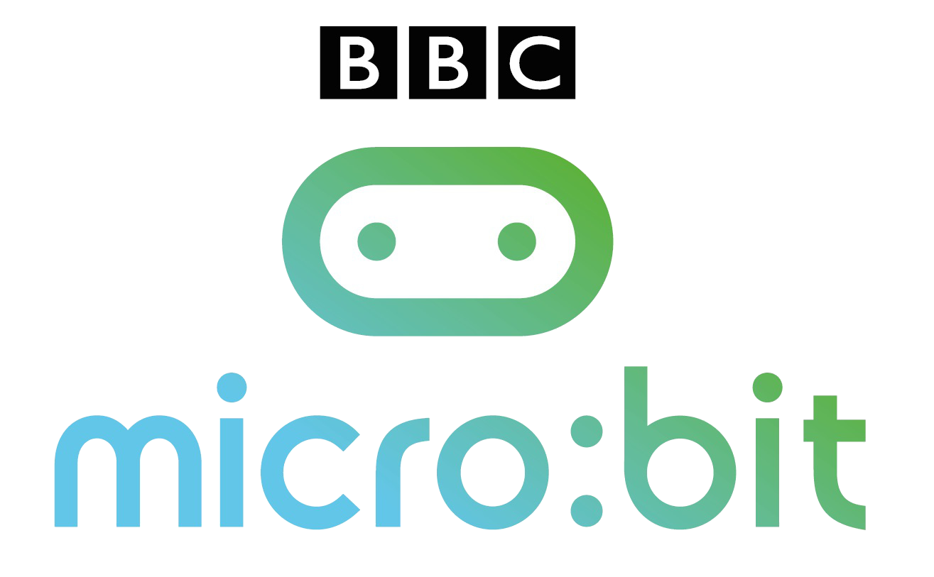

Slide 7
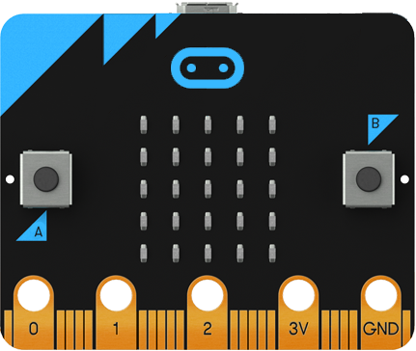
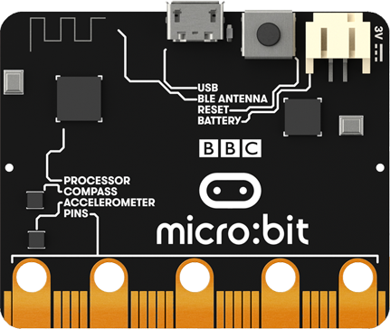
What is BBC micro:bit?
Front End
BBC Micro Bit - Open source hardware ARM-based embedded system
Designed by the BBC for use in computer education in the UK.
Pocket-sized codeable computer.
Device unveiled on 6 July 2015.
Back End
Main aims of the micro:bit
To “help a new generation get creative with technology and take advantage of the opportunities a career in science, technology, engineering and maths offers”.

Slide 8
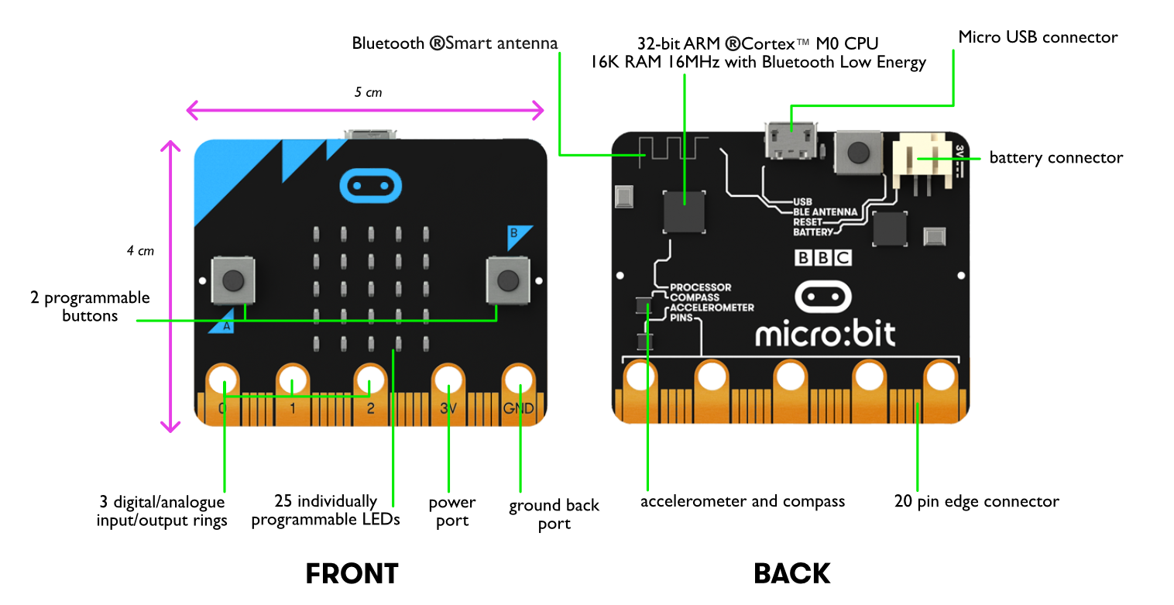
Key Features

Slide 9
STEPS TO START
THE
MICROBIT

Slide 10
Step 1: Connect it to your Windows PC
Connect the micro:bit to your computer using a micro USB cable.
Your micro:bit will show up on your computer as a drive called 'MICROBIT'.

Slide 11
Step 2: Program it on your Windows PC
You can program the micro:bit in the MakeCode Editor (which uses blocks) and Python (which is textual).

Slide 12

Step 3: Download it to your Windows PC
Click the Download button in the editor.
This will download a 'hex' file, which is a compact format of your program that your micro:bit can read. Once the hex file has downloaded, copy it to your micro:bit just like copying a file to a USB drive.

Slide 13
Step 4: Play it
The micro:bit will pause and the yellow LED on the back of the micro:bit will blink while your code is programmed. Once that's finished the code will run automatically!

Slide 14


